Slide 1

Predictive Modeling Against Financial Fraud
Rehan Khan

Slide 2



Agenda
Introduction
Problem
Goal
Modeling Steps
Conclusion

Slide 3




Introduction
For our analysis, we utilized one of PaySim's publicly available datasets on Kaggle. By leveraging this synthetic data, our goal is to gain a deeper understanding of features associated with fraudulent activities through data analysis, ultimately enabling us to make accurate predictions on unseen data. We further improved prediction performance by implementing various machine learning algorithms and rigorously evaluating each model.

Slide 4

Problem
Our data contains fraudulent transactions.
The transactions that were fraudulent were not all accurately flagged by the current model.

Slide 5
Goal
Create an improved fraud detection model that accurately predicts fraudulent transactions by a percentage of 90 or greater.

Slide 6
Steps of Machine Learning Model Creation
I.Data Wrangling
Cleaning, organizing and transforming raw data.
II. Exploratory Data Analysis
Step that identifies patterns in data and understanding outliers and features of dataset
III. Data Pre-processing
Changing raw data into a clean, usable format to prepare for final step of creating the machine learning model
IV. Modeling
Final step of the process where we apply different algorithms to processed data to see which model is most effective in predicting our target of a fraudulent transaction

Slide 7
Data Wrangling
Column Name | Data Type | Content
step | integer | unit of time in the real world. 1 step is 1 hour of time. Total steps 744 (30 days simulation)
type | string/categorical | transaction type
amount | float | transaction amount
nameOrig | string | customer initiating transaction
oldbalanceOrg | float | initial balance before the transaction
newbalanceOrig | float | new balance after transaction
nameDest | string | customer who is recipient
oldbalanceDest | float | initial balance of recipient
isFraud | boolean | new balance of recipient after transaction
isFlaggedFraud | boolean | if transaction is flagged as fraudulent
newbalanceDest | float | new balance after recipient transaction

Slide 8
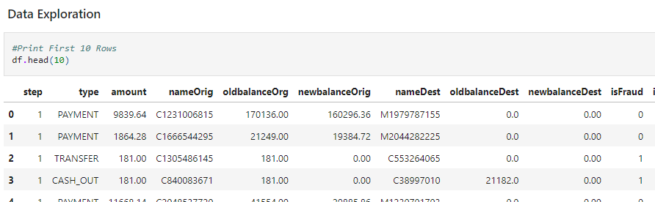
Data Wrangling
To facilitate analysis, we imported the file into Jupyter Notebooks as a DataFrame object and processed it using the Python programming language. The file was loaded into a DataFrame structure, consisting of 6,362,620 rows and 11 columns.

Slide 9
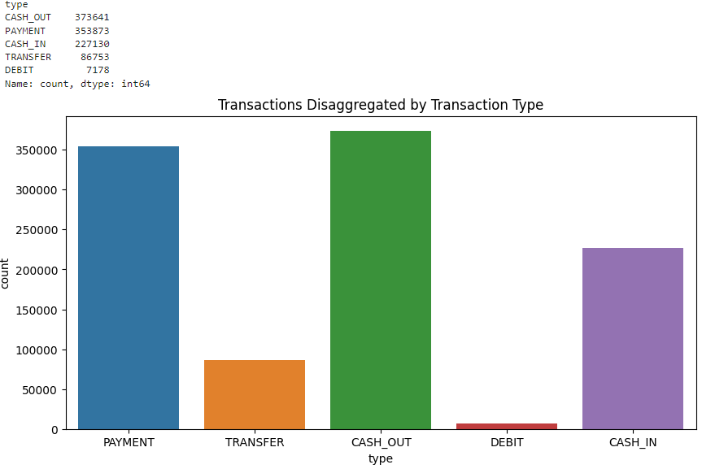
Exploratory Data Analysis
Figure on the right shows the types of transactions that were found in the dataset and their frequency.

Slide 10
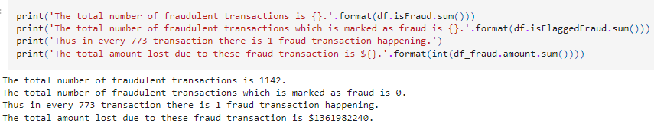
Exploratory Data Analysis
Figure above shows how many fraudulent transactions we had, the frequency of those fraudulent transactions, and the financial loss associated with fraudulent transactions.

Slide 11
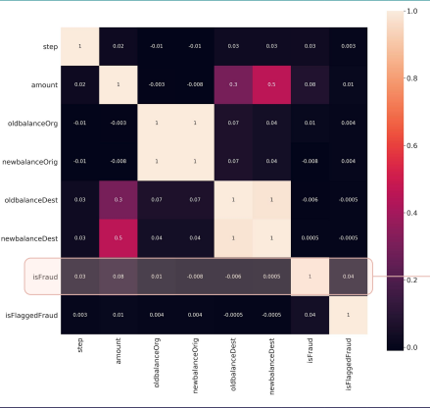
Correlation Coefficient Analysis of Fraudulent Transactions
Column Name | r
amount | 0.077
isFlaggedFraud | 0.044
step | 0.032
oldbalanceOrg | 0.010
newbalanceDest | 0.001
oldbalanceDest | -0.06
newbalanceOrig | -0.008

Slide 12
Correlation Coefficient Analysis of Fraudulent Transactions
Despite the importance of feature selection, using correlation as a metric did not allow us to narrow down our focus to a few features. None of the columns exhibited a satisfactory correlation score with the target variable 'isFraud' (all measured values were below |0.1|)

Slide 13
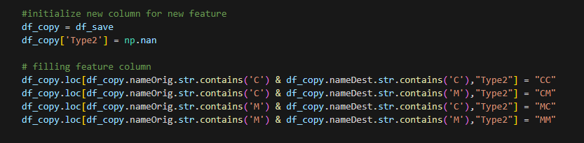
Data Preprocessing
For this step, I combined categorical values converting them to a new “type” to include information to process into the final machine learning algorithms I will use to test and predict our data. I did this using a numpy function to initialize a new “Type2” column while using the “.loc” function.

Slide 14
Data Preprocessing
Since not all features are providing information relevant to detect fraud, it is necessary to select only the best indicators for our target and build a model based on these features only.

Slide 15

Modeling
In this step, we established both a training and testing set, laying the groundwork for constructing our initial and fundamental model as a baseline. This baseline serves as a reference point, offering valuable insights into potential enhancements for our subsequent models. To establish this baseline, we initiated the process by standardizing the data, ensuring a uniform input regularization.

Slide 16
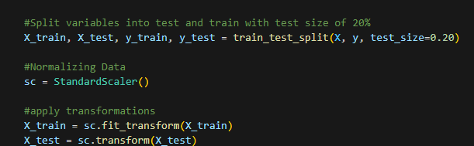
Modeling
Data was split with 20% going towards testing and 80% going towards training the model.

Slide 17
Models Used
Random Forest
Decision Tree
Logistic Regression

Slide 18
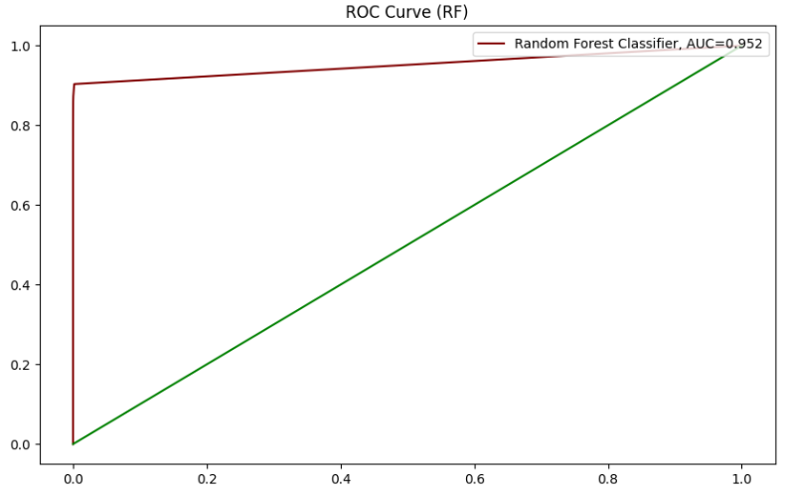
Model Evaluation
Random Forest was our best performing model.

Slide 19

Conclusion
In summary, we crafted advanced predictive classifier models to enhance the efficacy of our financial fraud detection system. The outcome was a notable improvement in detecting fraudulent operations, achieving higher recall scores across all three distinct algorithms compared to the original 'isFlaggedFraud' or baseline model. Here are our key findings:
1. We found that the Random Forest Algorithm Performed the best out of the three algorithms with an AUC score of 0.952.
2. Decision Tree algorithm performed the worst with an AUC score of 0.901.

Slide 20


Thank You

